Slide 1



Financial Forensics Project: Optimal Investment Portfolio Analysis
NOUFAL RAHMAN (21f1005287@ds.study.iitm.ac.in)
BHAVANA R (22f1001553@ds.study.iitm.ac.in)
NIJANDHAN K R (22f3003192@ds.study.iitm.ac.in)
SHAILESH KUMAR (21f1004597@ds.study.iitm.ac.in)

Slide 2

Project Background: Unveiling Investment Potential
Objective
The project uses advanced financial analysis techniques to assess the investment potential
of BSE-listed companies. This aims to reveal undervalued assets while mitigating investment risks.
Analysis Scope
The analysis encompasses various financial documents, including balance sheets, profit and loss statements, and cash flow statements. This provides a comprehensive view of each company’s financial position.

Slide 3
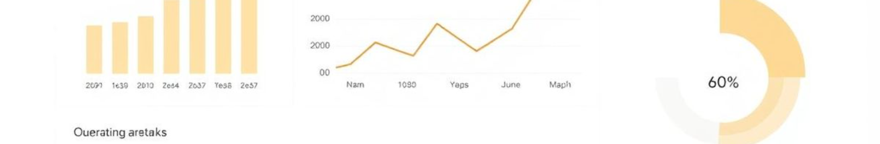



Data Sources and Key Metrics for Financial Analysis
Financial Documents
Utilizing annual P&L, balance sheets, cash flow statements, financial ratios, and stock prices to
form a comprehensive data foundation.
Key Metrics
Employing metrics like EPS for profitability, P/E ratio for valuation, ROE for efficiency, and Debt-to-Equity
for assessing financial risk.
Tools Used
Leveraging Pandas, NumPy, and CVXPY for efficient data handling and optimization, streamlining the
analytical process.

Slide 4




Portfolio Optimization Approach: Modern Portfolio Theory
MPT
1
Modern Portfolio Theory optimizes risk-return balance using Mean-Variance Optimization.
Covariance Matrix
2
Quantifies asset correlations, guiding diversification to mitigate risks.
Expected Returns
3
Derived from historical data for realistic future performance estimates.
Constraints
4
Includes full investment (weights sum to 1), no short selling (weights ≥ 0), and a budget of INR 10,00,000.

Slide 5

Portfolio Construction: Stock Selection and Allocation
Stock Selection
1
Employing EPS and ROE for profitability assessment. Also, using Debt-to-Equity for evaluating financial stability and volatility metrics for risk assessment.
2
Portfolio Allocation
Implementing weighted allocation to minimize risk-adjusted cost. This ensures that the portfolio is constructed to maximize returns while staying within acceptable risk levels.
Balancing Criteria
3
Balancing profitability, stability, and risk, creating a well-rounded portfolio designed to achieve sustainable growth and reduce potential losses.

Slide 6
Results and Insights: Performance Analysis and Metrics
Performance Analysis
Evaluation Metrics
Comparing initial vs. final investment value at T2. Computing portfolio delta and gain/loss percentage to gauge overall performance.
Assessing Sharpe Ratio, VaR (Value at Risk), and conducting Alpha and Beta analysis. These provide a detailed view of the portfolio’s risk-adjusted return and market sensitivity.
Result
The Optimized Portfolio achieved final value of X Rs with a portfolio delta of Y Rs resulting in percentage gain of Z %.

Slide 7
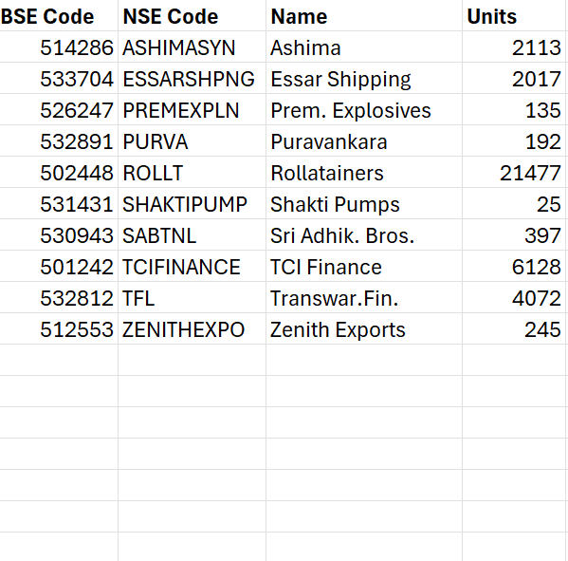
Final Output

